Slide 1



Project:Restaurent Billing System using java

Slide 2


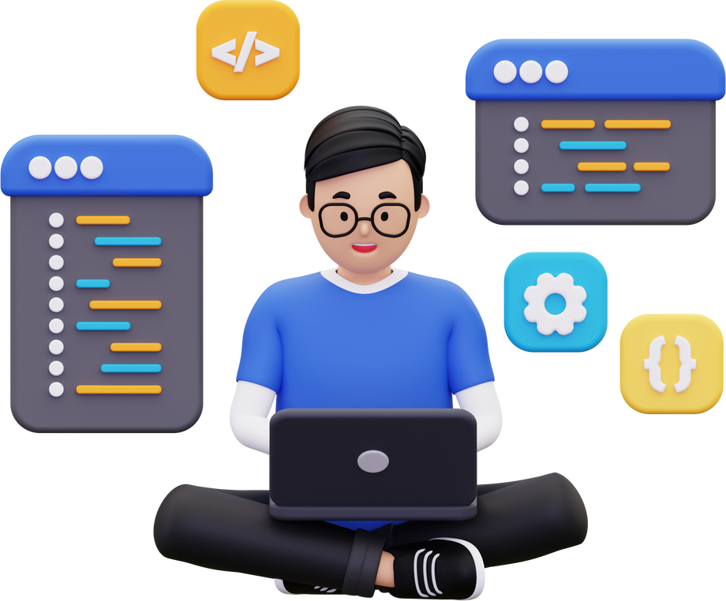
INTERNSHIP PROJECT IS COMPLETED BY:
HEAD OF THE DEPARTMENT
DR. G.S.N. MURTY, PH. D.
PROFESSOR DEPARTMENT OF CSE INTERNSHIP COORDINATOR
MR. A. HANUMANTHA RAO, MTECH ASSISTANT PROFESSOR
B.KRISHNAVENI (21MH1A0578), M.ANJANI (21MH1A05B1), CH.KEERTHI SRI(21MH1A0580) SK.SADHIK(21MH1A05C7)

Slide 3





WE B.KRISHNAVENI (21MH1A0578), M.ANJANI (21MH1A05B1), C.KEERTHI SRI(21MH1A0580) AND SK.SADHIK(21MH1A05C7)OF THE DEPARTMENT OF COMPUTER SCIENCE AND ENGINEERING, ADITYA COLLEGE OF ENGINEERING DO HEREBY DECLARE THAT I HAVE COMPLETED THE MANDATORY INTERNSHIP FROM 22-05-2023 TO 17-06-2023 IN TECHNICAL HUB AND WORKED ON A PROJECT ON RESTAURENT BILLING SYSTEM..

Slide 4
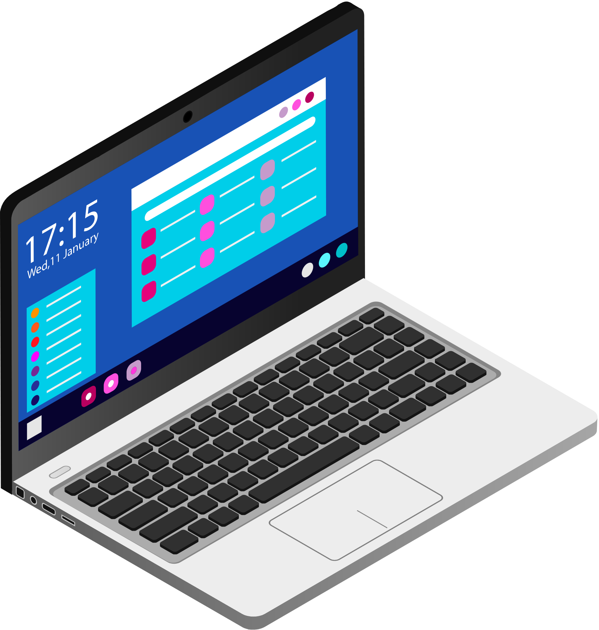

ABSTRACT
THE PROJECT "RESTAURANT BILLING SYSTEM" IS A BASIC PROGRAM USED IN RESTAURANT. THE MAIN AIM IS TO BE PERFORM THE PROCESS OF ORDERING AND BILLING OF A "RESTAURANT".
THE LANGUAGES BY USING JAVA, SQL.THIS IS THE PROFESSION OF MANAGING A RESTAURANT BILLING. IT INCLUDES THE MAJOR FUNCTION OF PLANNING, ORGANIZING EFFICIENTLY AND EFFECTIVELY PLAN MENUS AT PROFITABLE PRICES.THIS SYSTEM WILL HELP TO MANAGE THE RESTAURANT BILLING SYSTEM SYSTEMATICALLY. WE WILL PROVIDE SOFTWARE THAT CAN BE USED BY THE CASHIER.
THIS SYSTEM HAS THE CAPABILITY TO GIVE THE RECEIPT TO THE CUSTOMERS. TO REDUCE THE TIME, ENERGY, AND RESOURCES THAT WAS BEING CONSUMED WHEN PERFORMING A BILLING FOR THE CUSTOMER.THIS PROJECT ALSO CONTAINS THE DATA ANALYSIS CONCEPT THAT HELPS THE GROW OF THE BUSINESS AND ALSO THE DATA BASE THAT WHICH,STORES THE COMPLETE

Slide 5
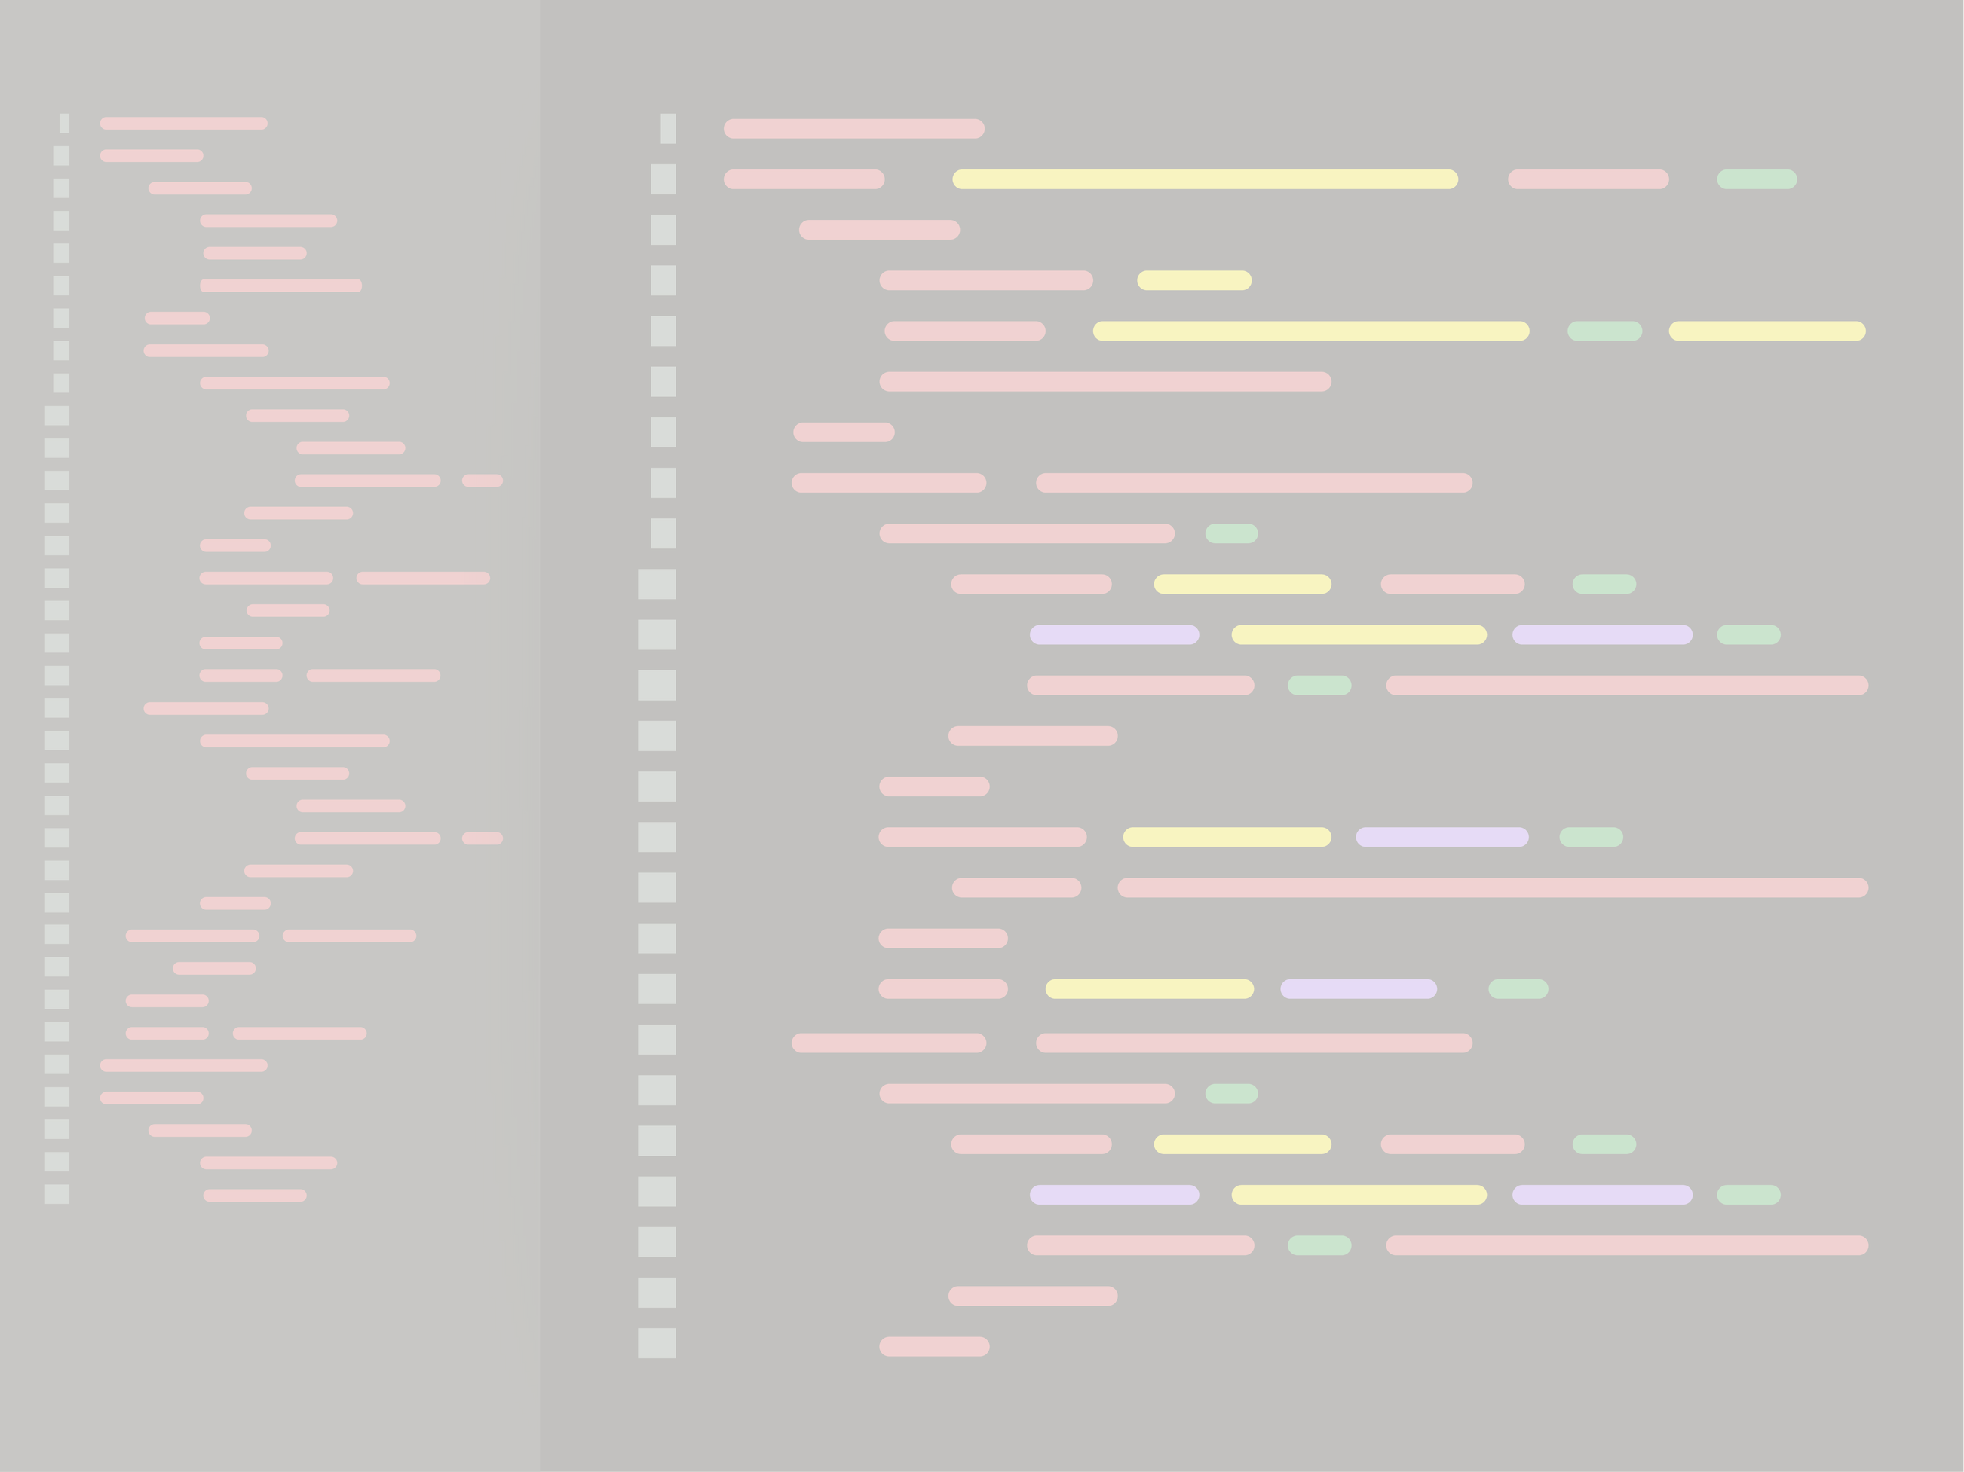
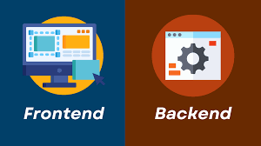
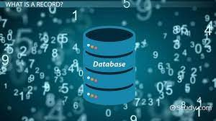

Techonologies
What we see and interact with as the visitors of a website, or as the end-user of a mobile app, is to considered front-end technology
Database technologies take information and store, organize, and process it in a way that enables users to easily and intuitively go back and find details they are searching for.
Database technologies take information and store, organize, and process it in a way that enables users to easily and intuitively go back and find details they are searching for.
A back-end developer writes code that forms the backbone of a website or app

Slide 6
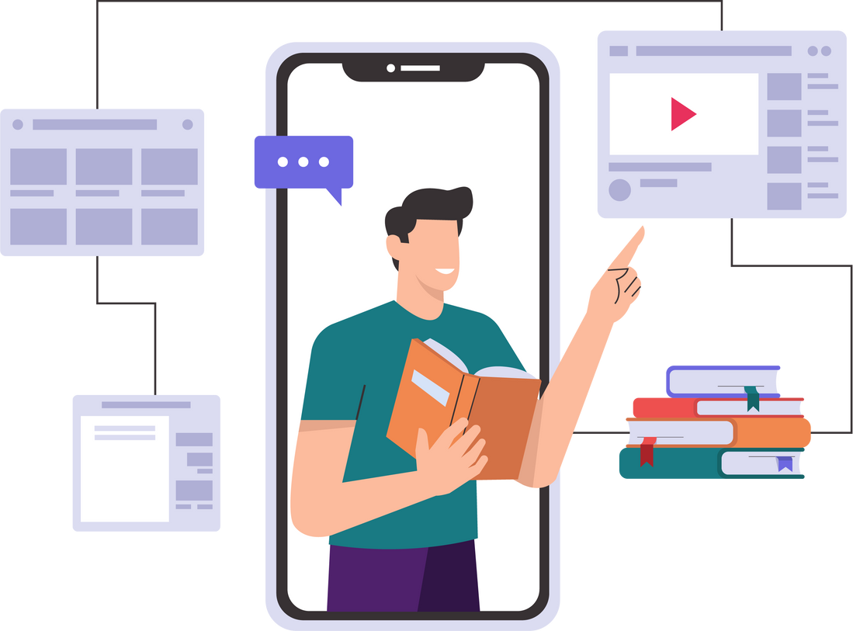



desiging technology
Figma is not a tool specifically used in Java programming but rather a web-based design and prototyping tool that is often used for designing user interfaces (UI) and user experiences (UX). In the context of a restaurant billing application in Java, Figma can be a valuable tool for designing and prototyping the graphical user interface (GUI) of your application. Here's how Figma can be used in the development process:
UI Design:
Collaboration:
Prototyping:
Component Libraries:
Visual Feedback:
Visual Feedback:

Slide 7
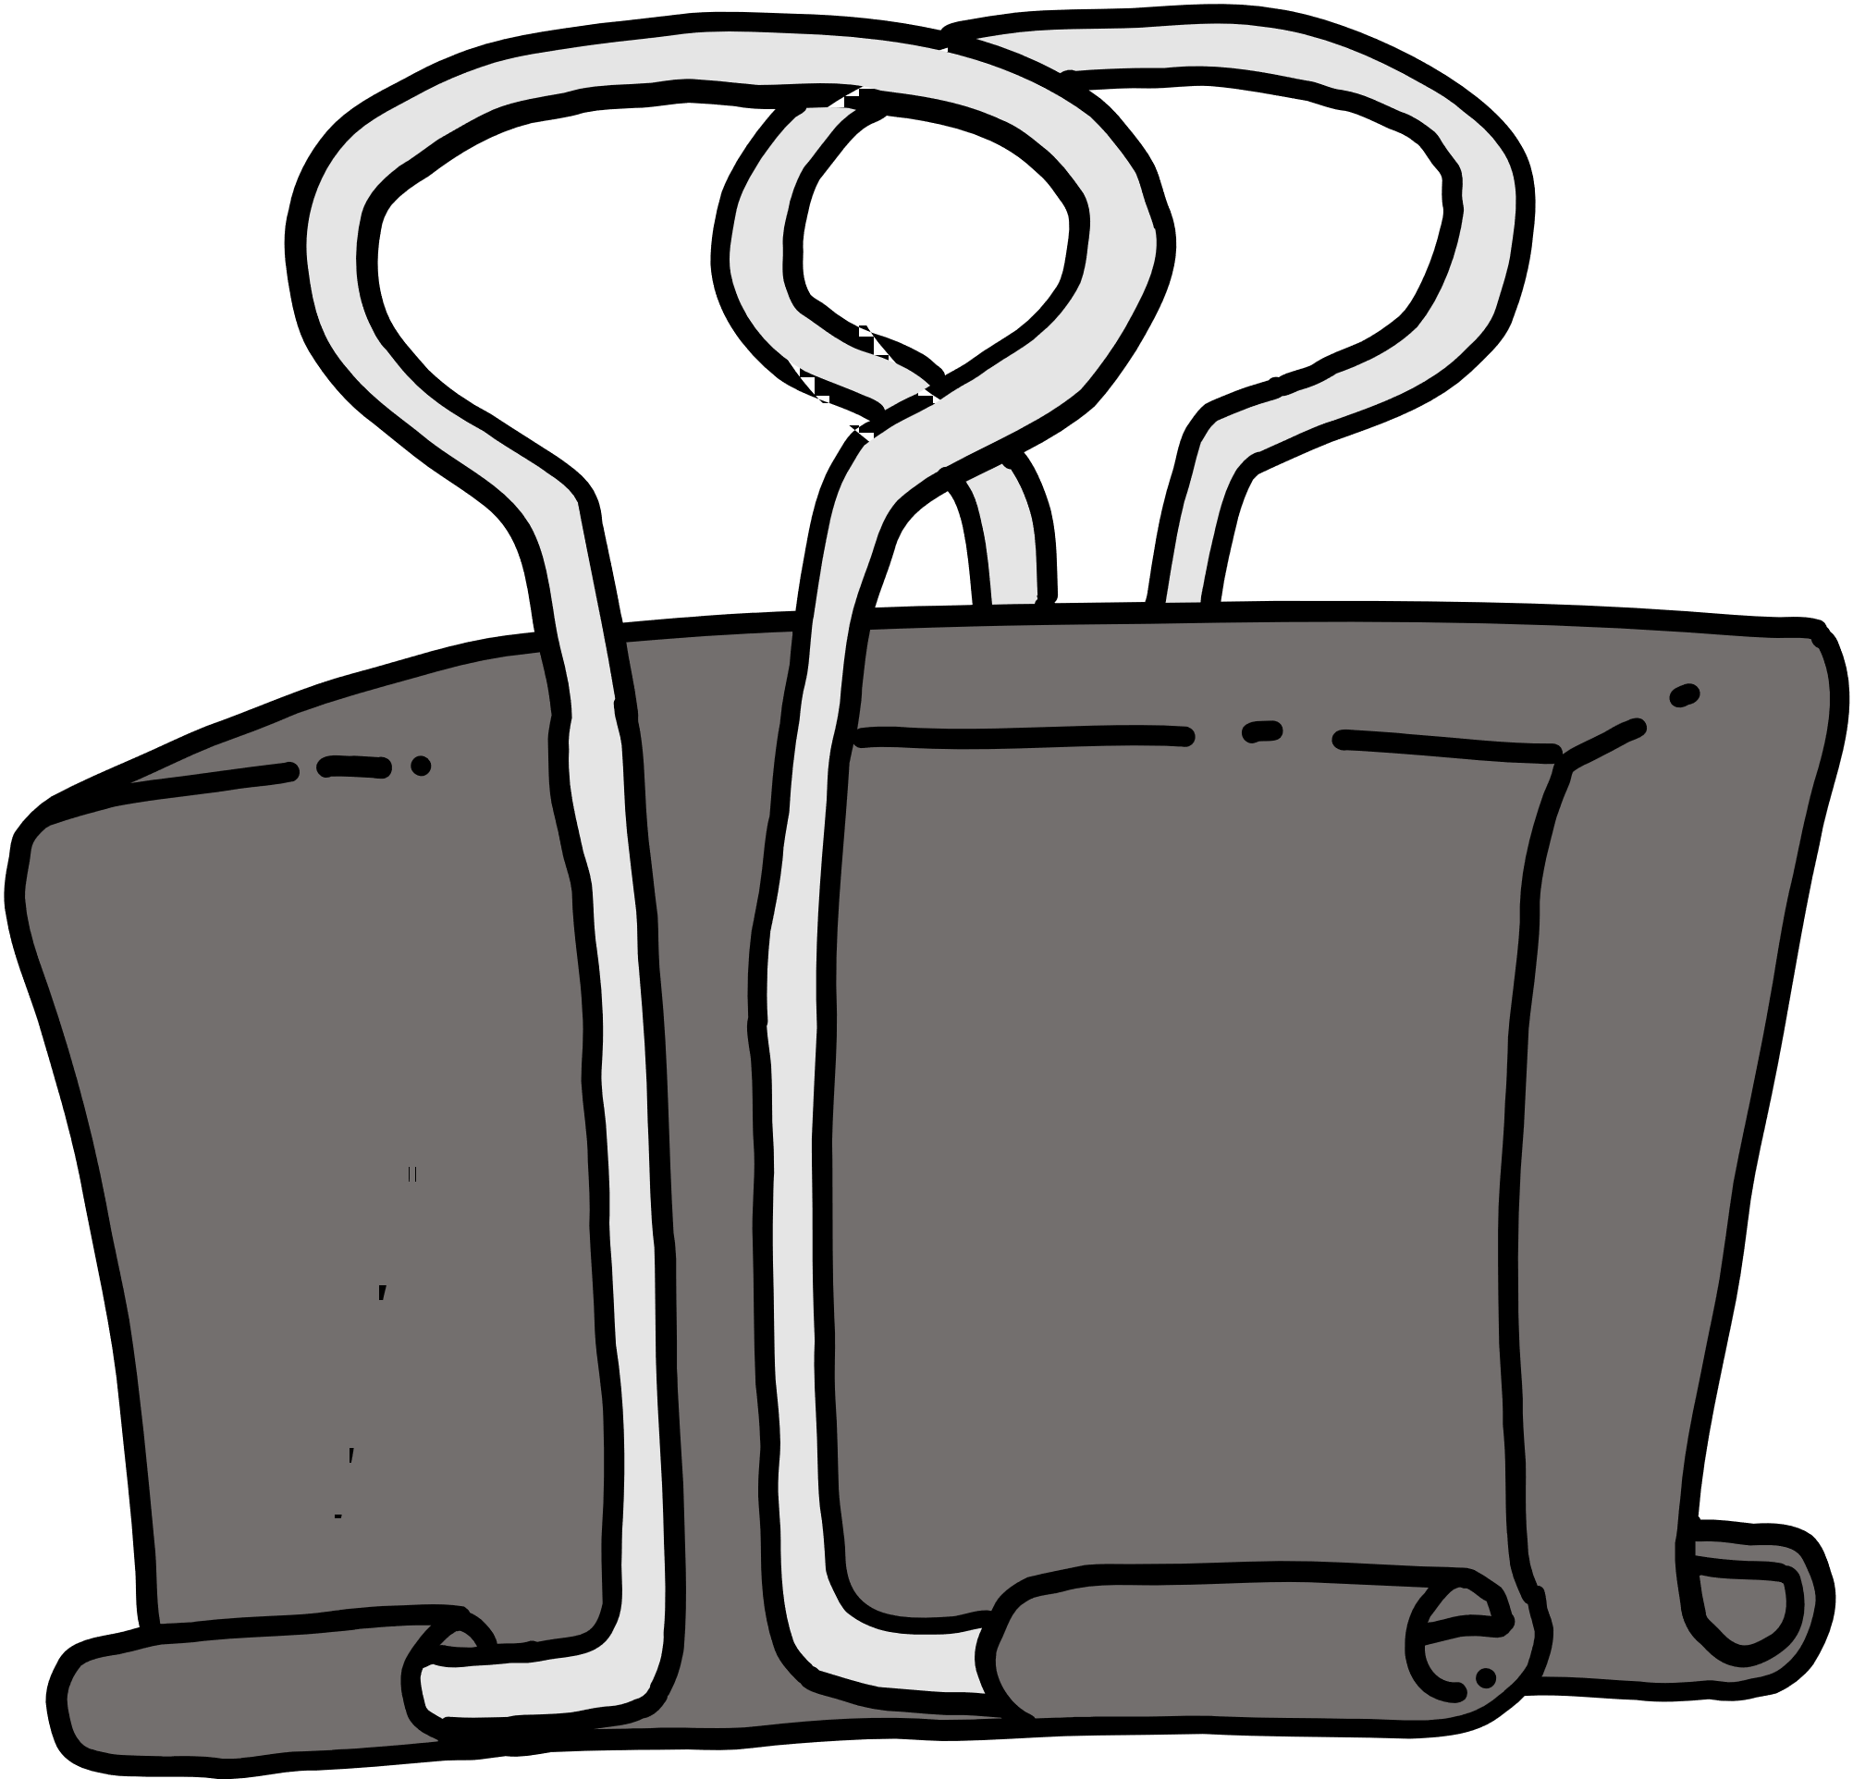

Advantages
Better Customer Service
Satisfaction of Employees
Fewer Errors
More Productivity
Effective Use of Time
Reduce Cost
Advanced Security

Slide 8
PROJECT REQUIREMENTS
Hardware Requirements:
Processor: intel – i3
RAM: 2GB
Hard disk: 256 GB
Software Requirements:
OS: Windows/MAC/Linux
JAVA: JDK Version(16,17,20)
Database: MYSQL Workbench
IDE: IntelliJ IDEA

Slide 9
PROJECT MODULES
Signup/Login pages
Order Page
Menu Page
Billing
Payment

Slide 10
1.Signup Page: It connects to a database, allows users to input a username and password, and checks these credentials against records in the database .
2.Order Management: It allows servers to take orders, modify them and send them to the kitchen for preparation.
3.Menu Management:This system maintains an updated menu with pricing, descriptions and availability of items
4.Billing: It calculates the total bill based on ordered items,applying taxes or discounts if applicable and generates invoices or receipts
5.Payment Processing:It accepts various payment methods(cash,credit/debit cards, mobile Payment)and records transmissions.

Slide 11
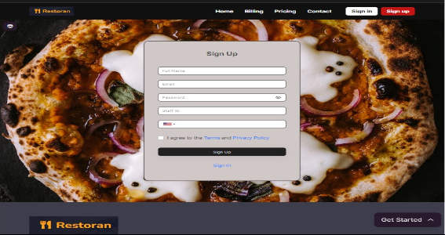
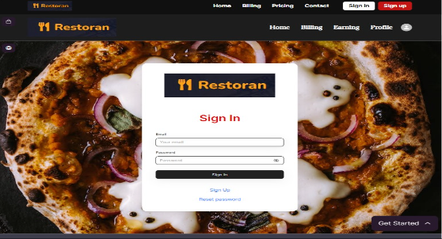
OUTPUT

Slide 12
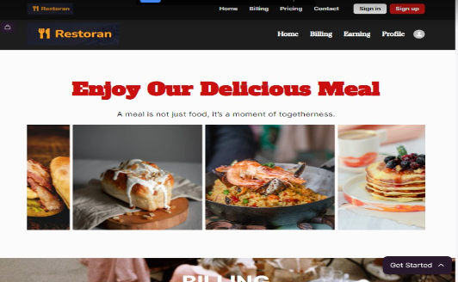
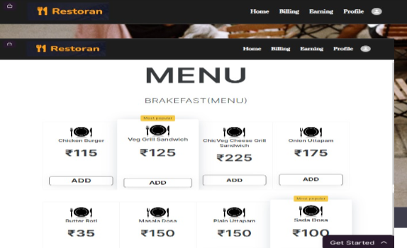
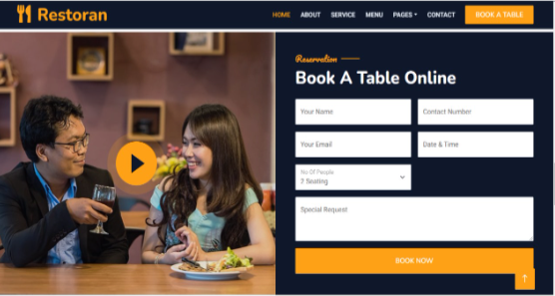

Slide 13
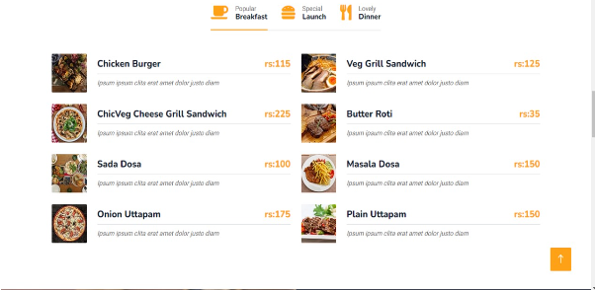
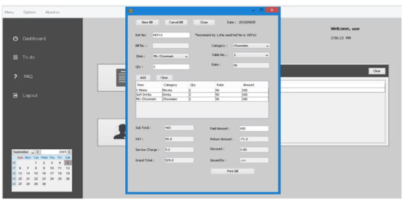

Slide 14
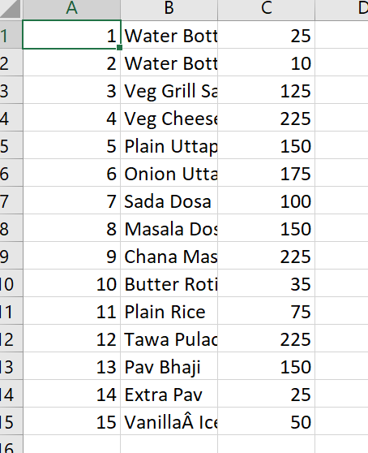
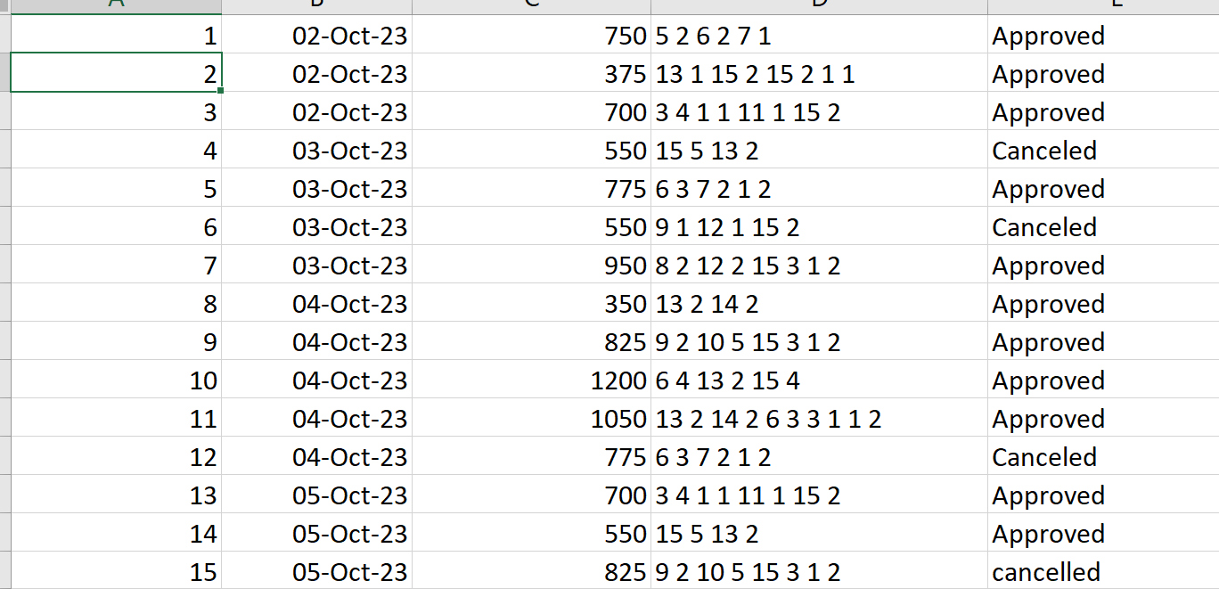
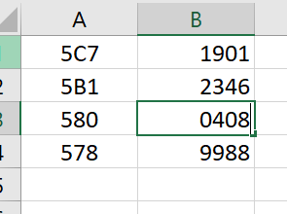
EMPLOYEE ID & PASSWD
MENU & PRICES
OUTPUT& DETAILS

Slide 15
Problem statement
&
solutions
Technical Glitches:
Problem: Technical issues, such as software crashes or hardware failures, can disrupt billing processes.
Resolution: Regularly maintain and update both software and hardware components. Implement a system for quick technical support and troubleshooting.
Slow Performance:
Problem: Slow response times can lead to long wait times for customers.
Resolution: Upgrade hardware if necessary to improve processing speed. Optimize the software to reduce latency. Ensure a reliable internet connection.

Slide 16
CONCLUSION
The outcome of all the time hard work is here. We have a system which takes the necessary choice of the customers according to the filter like category of the food. This is achieved through an easy to use graphical interface menu options. The users can add any number of items to the cart from any of the available food Categories. Customer according to the choice pay bill via cash or debit card or credit card method. Hence all the process works perfect, full filling of demand.

Slide 17

Resource page
The complete back-end code is avalible and it is completly designed in java
https://github.com/SADHIKSK/Resturant-app
https://www.figma.com/file/lUmUY7FGp9khSyHW39OF2X/Untitled?type=design&node-id=0%3A1&mode=design&t=GHqVsFarGsduwzGj-1eading

Slide 18


Thank's For Watching

